Slide 1


MSCI Corporate Events methodology
Version: May 2020

Slide 2
summary
This methodology book provides a description of the rules and guidelines followed by MSCI for the treatment of corporate events within the MSCI Global Investable Market Indexes.
It also provides guidance for the treatment of corporate events within MSCI Capped Weighted and Non-Market Capitalization Weighted indexes.
This methodology book focuses on the implementation of corporate events affecting securities across all the MSCI Equity Indexes and products.

Slide 3
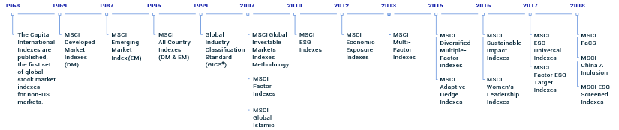
content
Introduction
Mergers & Acquisitions
Corporate Actions
Other Events Resulting in Changes in Number of Shares and FIFs and/or DIFs
Suspensions, Bankruptcies, Delistings and Country Classification Review
IPOs and Other Early Inclusions
Share freeze
General Announcement Policy for Corporate Events

Slide 4
Introduction(Cont)
Changes resulting from corporate events involve many aspects, including additions, deletions, changes in number of shares (NOS), changes in industry classification, and changes in Foreign Inclusion Factors (FIFs) and/or Domestic Inclusion Factors (DIFs) as a result of updated free float estimates.
As a general policy, changes resulting from corporate events are implemented in the MSCI Equity Indexes as they occur simultaneously with the event.
In addition, changes in number of shares are consistently coordinated with changes in FIFs and/or DIFs to accurately reflect the investability of the underlying securities.
Changes resulting from corporate events that could not be implemented on or near the effective dates, and where no Price Adjustment Factor (PAF) is necessary, are implemented at the following regularly scheduled Index Review.

Slide 5
Introduction(Cont)
Overall, the corporate events methodology can be described in four broad categories:
Mergers and Acquisitions (M&As) and Spin-offs
Corporate Actions
Other Events Resulting in Changes in Number of Shares and FIFs and/or DIFs
Suspensions, Delistings and Bankruptcies.

Slide 6
Mergers & Acquisitions
Definition: Mergers and acquisitions are the combination of two or more companies achieved through a mutual agreement or through a tender offer. They can be structured in a wide variety of ways with unique characteristics and complexities.
In a merger, the merging entities cease to exist and a new entity is created, while in an acquisition, the acquirer takes over the controlling interest in the acquired company. In the large majority of cases, the target subsequently ceases to exist as an independent entity.

Slide 7
Mergers & Acquisitions (CONT)
MSCI Action: For M&As involving share consideration (cash and share or share only), MSCI implements pending number of shares and/or free float updates simultaneously with the event.
Note that if the number of shares update is smaller than +-1% on a post-event number of shares basis, it will be implemented at a subsequent Index Review.

Slide 8
Mergers & Acquisitions (CONT)
2.1 Merger and Acquisitions via mutual agreement
2.1.1 Implementation Timing:
MSCI implements mergers and acquisitions executed via mutual agreement as of the close of the LAST TRADING DAY of the acquired entity or the merged entities.
For M&As, where the completion of the deal is conditional upon the resolution of pending shareholders’ legal action, MSCI waits until no legal action is pending before confirming the deletion of the target company. For acquisitions via scheme of arrangement (outside the US and Canada), MSCI waits for approval from shareholders at scheme meeting before announcing in “confirmed” status the deletion of the target security. However, MSCI does not wait for the results of the court meeting if the scheme is already approved at the scheme meeting by shareholders.

Slide 9
Mergers & Acquisitions (CONT)
2.1.2 Deletion Price:
Target securities are deleted from the MSCI Indexes at their closing market prices.

Slide 10
Mergers & Acquisitions (CONT)
2.2 Tender Offers
2.2.1 Definition:
Tender offers are offers to buy shares of a company, in many cases at a premium above the shares’ market price for cash and/or stock, with the objective of taking control of the acquired company.
When an acquirer offers cash to acquire a target company in a tender offer there is no change made to the acquirer.
When an acquirer offers new shares to acquire a target company in a tender offer, the changes in NOS and FIF of the acquirer are implemented simultaneously with the deletion of the target.

Slide 11
Mergers & Acquisitions (CONT)
2.2.2 Factors considered to assess the likelihood of tender offer success:
the announcement of the offer as friendly or hostile
a comparison of the offer price to the acquired security’s market price
the recommendation by the acquired company’s board of directors
the major shareholders’ stated intention whether to tender their shares
the required level of acceptance of shares tendered
the existence of pending regulatory approvals and/or legal actions
the market perception of the transaction, official preliminary results if any, and other additional conditions for the offer.

Slide 12
Mergers & Acquisitions (CONT)
2.2.3 Deletion Timing:
In hostile tender offers, MSCI systematically waits for the results of the tender offer to be publicly announced before making any related changes to the MSCI Indexes.
In friendly tender offers, the acquired or merging security is deleted from the MSCI Indexes with at least two full business days advance notification
2.2.4 Deletion prices:
MSCI uses market prices for implementation, unless the target security already ceased trading.

Slide 13
Mergers & Acquisitions (CONT)
2.2.5 Announcement policy:
MSCI reflects hostile tender offers once they are launched using an “Undetermined” announcement status, except when the target has an MSCI country of classification of the USA, where hostile tender offers are reflected using an “Acknowledge” announcement status. Once the results of the hostile tender offer have been announced, MSCI will send a “Confirmed” announcement with two full business days of advance notification before implementing any changes.
For friendly tender offers, MSCI sends an announcement with an “Undetermined” status with at least 3 weeks advance notification. A “Confirmed” announcement is sent at least two full business days before the effective date of the implementation.

Slide 14
Mergers & Acquisitions (CONT)
2.6 Pro Forma Float Calculation For M&As
2.6.1 Pro Forma Float Calculations for M&As
2.6.1.1 Cash M&A transactions: Cash M&A transactions have no impact on the free float of the securities of the acquiring company, as no new shares are issued.
2.6.1.2 Stock-for-Stock M&A Transactions: In stock-for-stock M&A transactions, the pro forma free float of the securities of the acquiring or merged entity is calculated as a weighted average of the free float of the shares of the pre-event entities.
2.6.1.3 Stock and Cash M&A Transactions: In M&A transactions involving cash and stock, the pro-forma free float of the securities of the acquiring or merged entity is calculated based on the information provided by the company indicating which shareholders will be receiving newly issued shares.

Slide 15
Mergers & Acquisitions (CONT)
2.7 Mergers and acquisitions treatment in capped
weighted and non-market capitalization weighted indexes
Glossary of Terms:
1. Constraint Factor (CF): A primary factor used as a component of constituent weighting in non-market capitalization weighted indexes or where weighting is adjusted by a capping mechanism. The implementation of certain types of corporate events impacts security level constraint factor calculation.
2. Variable Weighting Factor (VWF) – The Variable Weighting Factor (VWF) is a factor that is used to offset the change to market capitalization that occurs as a result of a corporate event implementation in Non-Market Capitalization Weighted indexes. The VWF is also applied to offset any changes in post event market capitalization that may result from FIF rounding.

Slide 16
Mergers & Acquisitions (CONT)
2.7 Mergers and acquisitions treatment in capped
weighted and non-market capitalization weighted indexes
3. Full Market Cap Adjustment Factor (FMCAF): A factor that is used in index constituent weighting calculation defined as (Inclusion Factor (i.e. FIF)) *(Constraint Factor)*(Variable Weighting Factor).
4. Parent Index: The index that serves as the underlying basis for a specific Capped Weighted or Non-Market Capitalization Weighted index.

Slide 17
Mergers & Acquisitions (CONT)
2.7 Mergers and acquisitions treatment in capped
weighted and non-market capitalization weighted indexes
5. Number of Shares (NOS) Inflow Ratio: The NOS inflow ratio reflects the consideration terms of the corporate event. The formula for the calculation of the NOS Inflow Ratio related to specific event types is explained in the table below.
6. Inflow Security: Any security which undergoes an increase in its number of shares as a result of the corporate event implementation. Inflows are identified through corporate event terms (e.g. for an Acquisition with share consideration, Acquirer security will be treated as an Inflow Security)

Slide 18
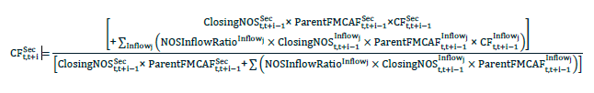
Mergers & Acquisitions (CONT)
2.7 Mergers and acquisitions treatment in capped
weighted and non-market capitalization weighted indexes
7. Counterpart Security: The security involved in a corporate event from which the inflow is originating. (e.g. for an Acquisition with share consideration, Target security will be treated as a Counterpart Security)
8. Maintenance Formula: When the Inflow Security is already an Index constituent, the security’s post event CF is calculated using the Maintenance Formula:

Slide 19
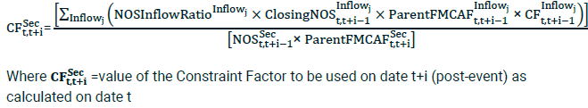
Mergers & Acquisitions (CONT)
2.7 Mergers and acquisitions treatment in capped
weighted and non-market capitalization weighted indexes
9. Addition Formula: When the Counterpart Security is an Index Constituent but the Inflow Security is not and will be added to the Index as per event implementation, the Inflow Security’s post event CF is calculated using the Addition Formula

Slide 20
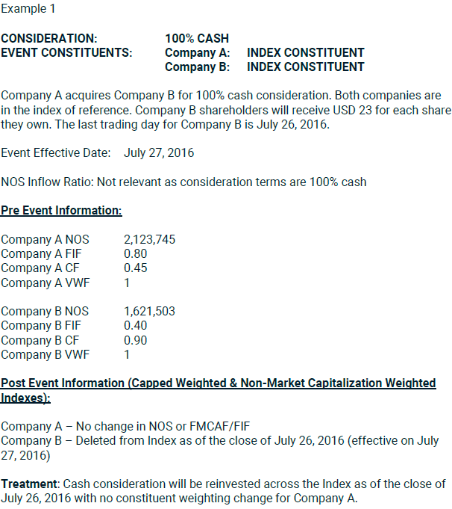
Mergers & Acquisitions (CONT)
M&A examples

Slide 21
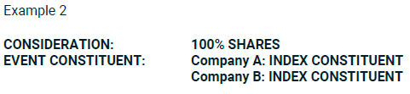
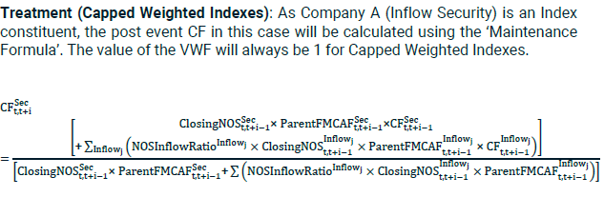
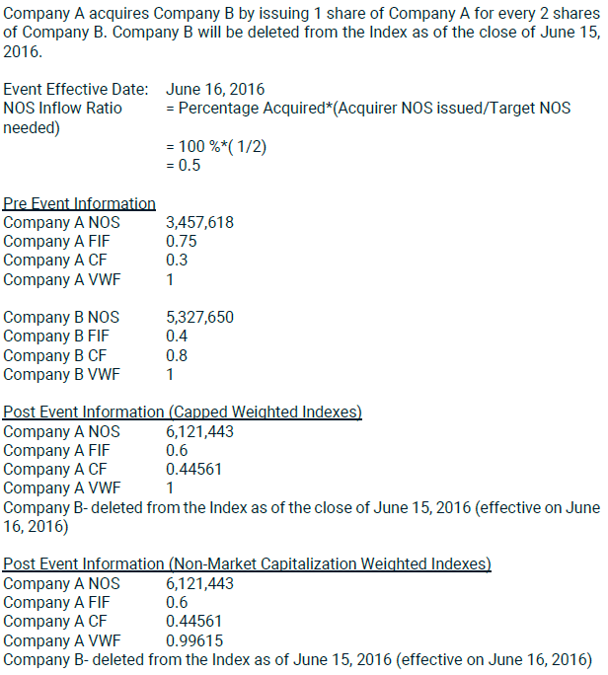
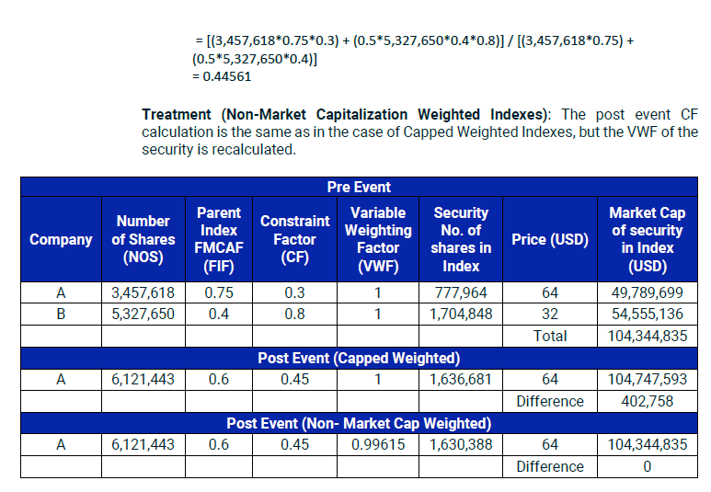
Mergers & Acquisitions (CONT)
M&A examples

Slide 22
appendix
22

Slide 23
About MSCI
For more than 40 years, MSCI’s research-based indexes and analytics have helped the world’s leading investors build and manage better portfolios. Clients rely on our offerings for deeper insights into the drivers of performance and risk in their portfolios, broad asset class coverage and innovative research.
Our line of products and services includes indexes, analytical models, data, real estate benchmarks and ESG research.
MSCI serves 99 of the top 100 largest money managers, according to the most recent P&I ranking.
For more information, visit us at www.msci.com.

